Slide 1

Introduction to Probabilistic Machine Learning
Ralf Herbrich
Non-Bayesian Classification

Slide 2
Overview
Geometry of Linear Classifiers
Fisher's Linear Discriminant
Perceptron Learning Algorithm
Logistic Regression

Slide 3
Overview
Classification Learning
Fisher's Linear Discriminant
Perceptron Learning Algorithm
Logistic Regression

Slide 4
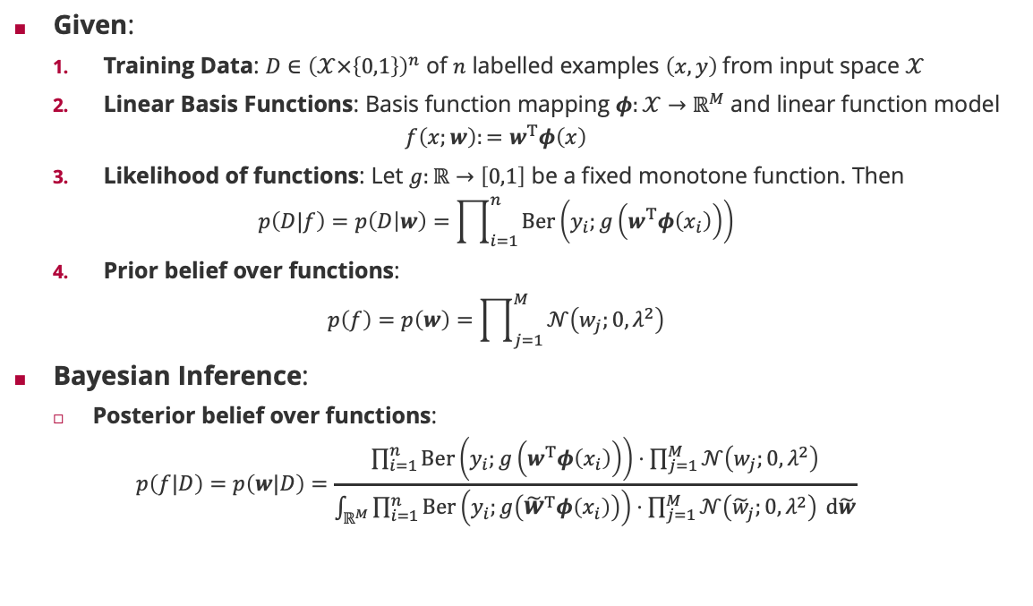
Classification Learning Setting
Given:
Training Data: $D∈{\left(𝒳×\left\{0,1\right\}\right)}^{n}$ of $n$ labelled examples $\left(x,y\right)$from input space $𝒳$
Linear Basis Functions: Basis function mapping $φ:𝒳→ℝ^{M}$ and linear function model
$$f\left(x;w\right):=w^{T}φ\left(x\right)$$
Likelihood of functions: Let $g:ℝ→\left[0,1\right]$ be a fixed monotone function. Then
$$p\left(D|f\right)=p\left(D | w\right)=\prod_{i=1}^{n}{Ber\left(y_{i};g\left(w^{T}φ\left(x_{i}\right)\right)\right)}$$
Prior belief over functions:
$$p\left(f\right)=p\left(w\right)=\prod_{j=1}^{M}{𝒩\left(w_{j};0,λ^{2}\right)}$$
Bayesian Inference:
Posterior belief over functions:
$$p\left(f|D\right)=p\left(w|D\right)=\frac{\prod_{i=1}^{n}{Ber\left(y_{i};g\left(w^{T}φ\left(x_{i}\right)\right)\right)}⋅\prod_{j=1}^{M}{𝒩\left(w_{j};0,λ^{2}\right)}}{\int_{ℝ^{M}}{\prod_{i=1}^{n}{Ber\left(y_{i};g\left({\tilde{w}}^{T}φ\left(x_{i}\right)\right)\right)}⋅\prod_{j=1}^{M}{𝒩\left({\tilde{w}}_{j};0,λ^{2}\right)} d\tilde{w}}}$$
$$g\left(t\right)=\frac{\exp\left(t\right)}{1+\exp\left(t\right)}$$
$$\lim_{s→∞}{g\left(s⋅t\right)}=𝕀\left(t>0\right)$$

Slide 5
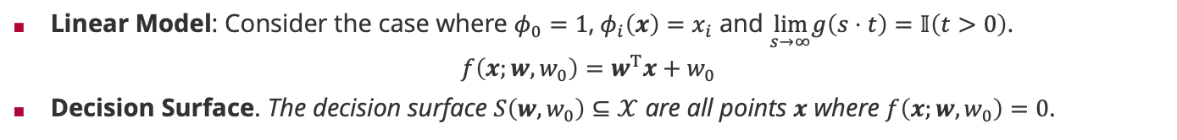
Geometry of Linear Classifiers
Linear Model: Consider the case where $φ_{0}=1$,$φ_{i}\left(x\right)=x_{i}$ and $\lim_{s→∞}g\left(s⋅t\right)=𝕀\left(t>0\right)$.
$$f\left(x;w,w_{0}\right)=w^{T}x+w_{0}$$
Decision Surface. The decision surface $S\left(w,w_{0}\right)⊆𝒳$ are all points $x$ where $f\left(x;w,w_{0}\right)=0$.
$${w^{T}x}_{A}+w_{0}=0$$
$$x=αw$$
$$x=x_{1}+x_{2}+x_{⊥}=\left(α+r\right)w+x_{⊥}$$
$${w^{T}x}_{B}+w_{0}=0$$
$$w^{T}x+w_{0}=αw^{T}w+w_{0}=0$$
$$w^{T}x=\left(α+r\right){\left\|w\right\|}^{2}⇔r=\frac{w^{T}x+w_{0}}{{\left\|w\right\|}^{2}}$$
$$w^{T}\left(x_{B}−x_{A}\right)=0$$
$$\left\|x\right\|=α\left\|w\right\|=−\frac{w_{0}}{{\left\|w\right\|}^{2}}⋅\left\|w\right\|=−\frac{w_{0}}{\left\|w\right\|}$$
$$\left\|x_{2}\right\|=r\left\|w\right\|=\frac{w^{T}x+w_{0}}{\left\|w\right\|}$$

Slide 6
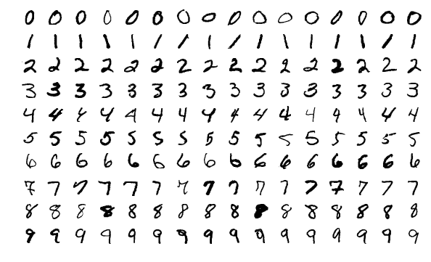



Classification Learning Example: MNIST
MNIST (Modified National Institute of Standards and Technology database) is a database of handwritten digits
Created in 1998 from two datasets of handwritten digits of high-school students and American Census Bureau employees
Created by Yann LeCun, Corinna Cortes, and Christ Burges
60,000 training images/10,000 test images
Original black-and-white images were scaled to 28x28 pixels and anti-aliased to give grey scales
Standard dataset to compare classification learning algorithms from 1998 – 2010 (before ImageNet)
Smallest prediction error: 0.18% (2018)
Yann LeCun (1960 – )
Corinna Cortes (1961 – )
Chris Burges (1960 – )

Slide 7
Overview
Classification Learning
Fisher's Linear Discriminant
Perceptron Learning Algorithm
Logistic Regression

Slide 8
Marginal Distribution after Linear Projection
Idea: Given a linear basis function model $f\left(x;w,w_{0}\right):=w^{T}φ\left(x\right)+w_{0}$, estimate the marginal distribution of the $f\left(x_{i}\right)$ with a Normal distribution separately for the class $y_{i}=0$ and $y_{i}=1$

Slide 9
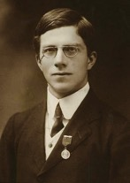
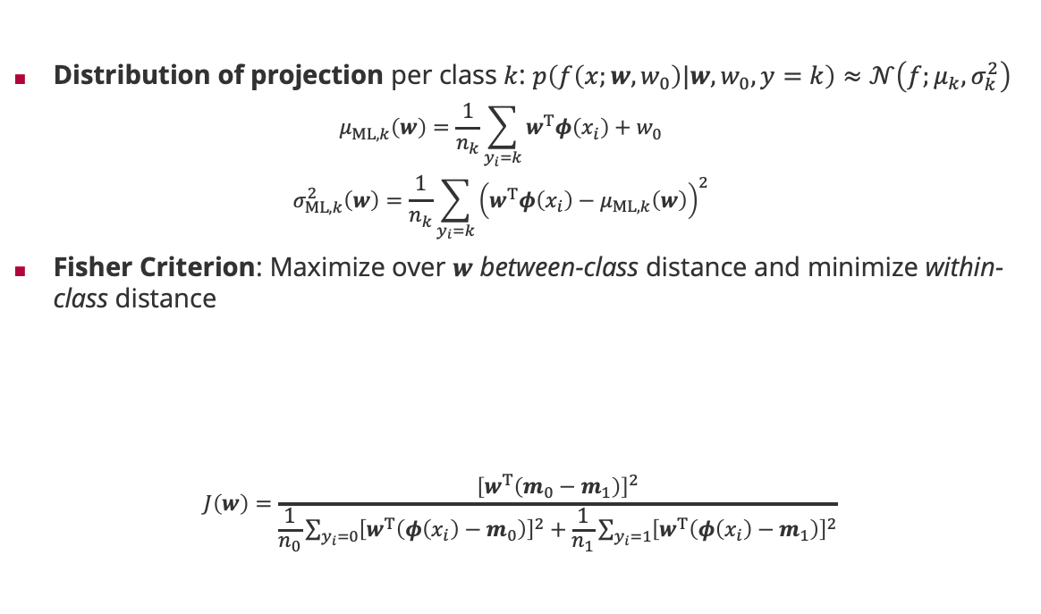

Fisher’s Criterion
Distribution of projection per class $k$: $p\left(f\left(x;w,w_{0}\right)|w,w_{0},y=k\right)≈𝒩\left(f;μ_{k},σ_{k}^{2}\right)$
$$μ_{ML,k}\left(w\right)=\frac{1}{n_{k}}\sum_{y_{i}=k}{w^{T}φ\left(x_{i}\right)}+w_{0}$$
$$σ_{ML,k}^{2}\left(w\right)=\frac{1}{n_{k}}\sum_{y_{i}=k}{{\left(w^{T}φ\left(x_{i}\right)−μ_{ML,k}\left(w\right)\right)}^{2}}$$
Fisher Criterion: Maximize over $w$ between-class distance and minimize within-class distance
$$J\left(w\right)=\frac{{\left[w^{T}\left(m_{0}−m_{1}\right)\right]}^{2}}{\frac{1}{n_{0}}\sum_{y_{i}=0}{{\left[w^{T}\left(φ\left(x_{i}\right)−m_{0}\right)\right]}^{2}}+\frac{1}{n_{1}}\sum_{y_{i}=1}{{\left[w^{T}\left(φ\left(x_{i}\right)−m_{1}\right)\right]}^{2}}}$$
Sir Ronald Fisher (1890 – 1962)
$$J\left(w\right)=\frac{{\left[μ_{ML,0}\left(w\right)−μ_{ML,1}\left(w\right)\right]}^{2}}{σ_{ML,0}^{2}\left(w\right)+σ_{ML,1}^{2}\left(w\right)}$$
$$m_{k}:=\frac{1}{n_{k}}\sum_{y_{i}=k}{φ\left(x_{i}\right)}$$
$w_{0}$ cancels

Slide 10
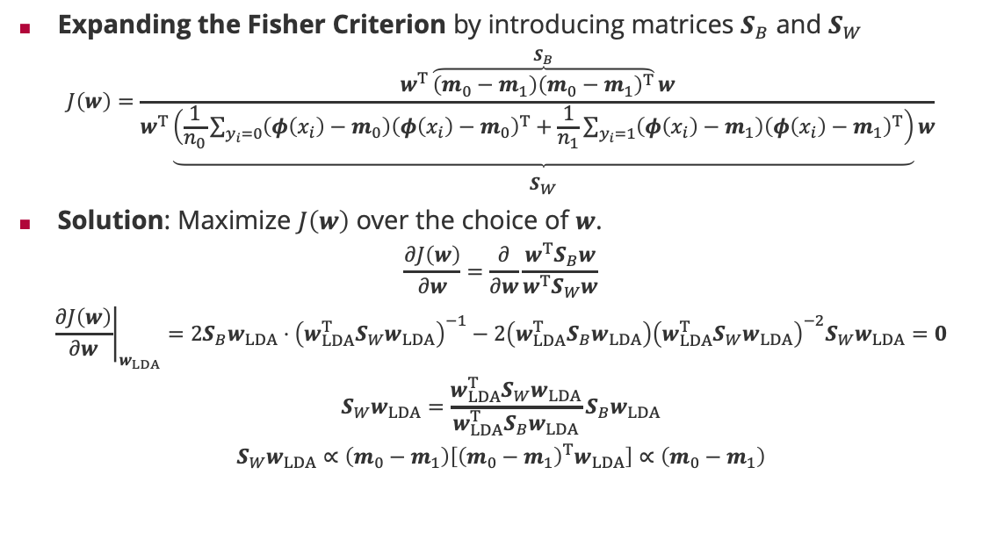
Fisher’s Linear Discriminant Analysis (LDA)
Expanding the Fisher Criterion by introducing matrices $S_{B}$ and $S_{W}$
$$J\left(w\right)=\frac{w^{T}\overset{S_{B}}{\overbrace{\left(m_{0}−m_{1}\right){\left(m_{0}−m_{1}\right)}^{T}}}w}{w^{T}\underset{\begin{aligned} \\ S_{W}\end{aligned}}{\underbrace{\left(\frac{1}{n_{0}}\sum_{y_{i}=0}{\left(φ\left(x_{i}\right)−m_{0}\right){\left(φ\left(x_{i}\right)−m_{0}\right)}^{T}}+\frac{1}{n_{1}}\sum_{y_{i}=1}{\left(φ\left(x_{i}\right)−m_{1}\right){\left(φ\left(x_{i}\right)−m_{1}\right)}^{T}}\right)}}w}$$
Solution: Maximize $J\left(w\right)$ over the choice of $w$.
$$\frac{∂J\left(w\right)}{∂w}=\frac{∂}{∂w}\frac{w^{T}S_{B}w}{w^{T}S_{W}w}$$
$${\left.\frac{∂J\left(w\right)}{∂w}\right|}_{w_{LDA}}=2S_{B}w_{LDA}⋅{\left(w_{LDA}^{T}S_{W}w_{LDA}\right)}^{−1}−2\left(w_{LDA}^{T}S_{B}w_{LDA}\right){\left(w_{LDA}^{T}S_{W}w_{LDA}\right)}^{−2}S_{W}w_{LDA}=0$$
$$S_{W}w_{LDA}={\frac{w_{LDA}^{T}S_{W}w_{LDA}}{w_{LDA}^{T}S_{B}w_{LDA}}S}_{B}w_{LDA}$$
$$S_{W}w_{LDA}∝\left(m_{0}−m_{1}\right)\left[{\left(m_{0}−m_{1}\right)}^{T}w_{LDA}\right]∝\left(m_{0}−m_{1}\right)$$
Rayleigh coefficient
Real numbers
Real number
$$w_{LDA}∝S_{W}^{−1}\left(m_{0}−m_{1}\right)$$

Slide 11
Fisher’s Linear Discriminant Analysis (ctd.)
Question: How to determine the optimal threshold $w_{0}$?
Idea: Choose it such that the weighted mid-point between the two means $μ_{ML,0}\left(w_{LDA}\right)$ and $μ_{ML,1}\left(w_{LDA}\right)$ is exactly at zero (remember $g\left(x\right)=𝕀\left(x>0\right)$)!
$${\frac{n_{0}}{n_{0}+n_{1}}⋅μ}_{ML,0}\left(w_{LDA}\right)+{\frac{n_{1}}{n_{0}+n_{1}}⋅μ}_{ML,1}\left(w_{LDA}\right)=0$$
$$\frac{n_{0}}{n_{0}+n_{1}}\left(\frac{1}{n_{0}}\sum_{y_{i}=0}{w_{LDA}^{T}φ\left(x_{i}\right)}+w_{LDA,0}\right)+\frac{n_{1}}{n_{0}+n_{1}}\left(\frac{1}{n_{1}}\sum_{y_{i}=1}{w_{LDA}^{T}φ\left(x_{i}\right)}+w_{LDA,0}\right)=0$$
$$w^{T}\underset{\begin{aligned} \\ m\end{aligned}}{\underbrace{\left(\frac{1}{n_{0}+n_{1}}\sum_{i=1}^{n_{0}+n_{1}}{φ\left(x_{i}\right)}\right)}}+w_{LDA,0}=0$$
$$w_{LDA,0}=−w_{LDA}^{T}m$$

Slide 12
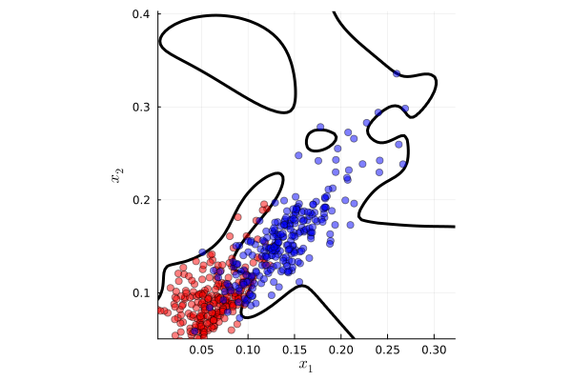
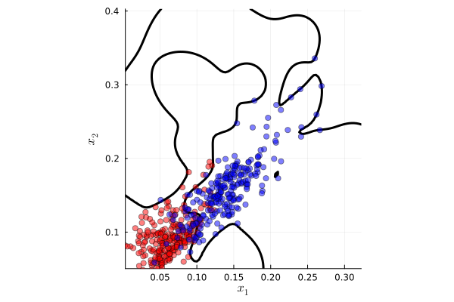
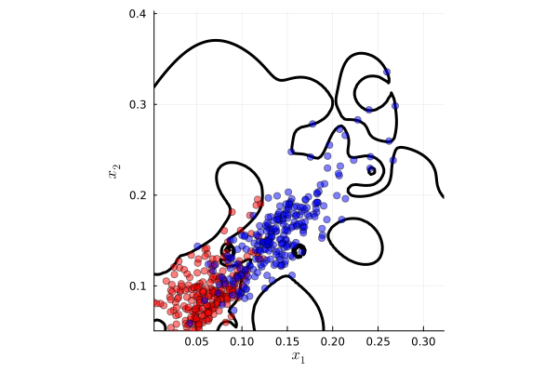

Fisher‘s Linear Discriminant Analysis in Pictures
$3$ variances
$5$ variances
$9$ variances
Feature values of Gaussian density in 2D on a $5×5$ grid at $n$ decaying variances

Slide 13
Overview
Classification Learning
Fisher's Linear Discriminant
Perceptron Learning Algorithm
Logistic Regression

Slide 14
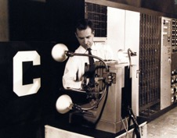
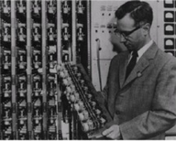
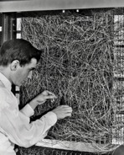
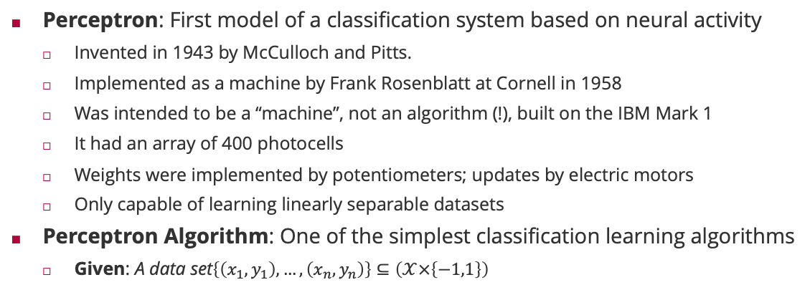
Perceptron Learning
Perceptron: First model of a classification system based on neural activity
Invented in 1943 by McCulloch and Pitts.
Implemented as a machine by Frank Rosenblatt at Cornell in 1958
Was intended to be a “machine”, not an algorithm (!), built on the IBM Mark 1
It had an array of 400 photocells
Weights were implemented by potentiometers; updates by electric motors
Only capable of learning linearly separable datasets
Perceptron Algorithm: One of the simplest classification learning algorithms
Given: A data set$\left\{\left(x_{1},y_{1}\right),…,\left(x_{n},y_{n}\right)\right\}⊆\left(𝒳×\left\{−1,1\right\}\right)$
Initialize: A weight vector $w=0$
Iterate through all examples and if $y_{i}w^{T}φ\left(x_{i}\right)≤0$ then $w←w+y_{i}φ\left(x_{i}\right)$
Stop when no mistakes were made on all data

Slide 15
Perceptron Algorithm in Action

Slide 16
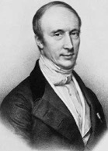



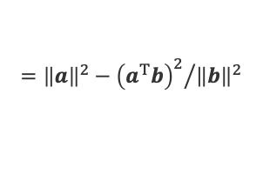


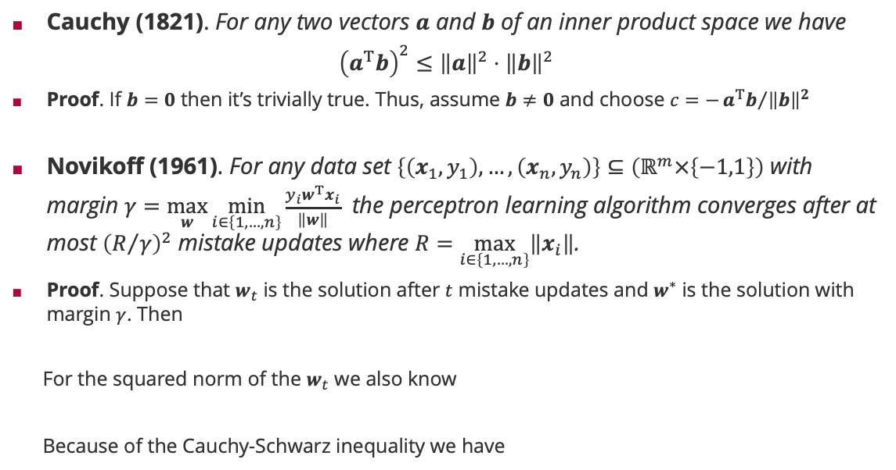











Novikoff’s Perceptron Convergence Theorem
Cauchy (1821). For any two vectors $a$ and $b$ of an inner product space we have
$${\left(a^{T}b\right)}^{2}≤{\left\|a\right\|}^{2}⋅{\left\|b\right\|}^{2}$$
Proof. If $b=0$ then it’s trivially true. Thus, assume $b≠0$ and choose $c=−{a^{T}b}/{{\left\|b\right\|}^{2}}$
Novikoff (1961). For any data set $\left\{\left(x_{1},y_{1}\right),…,\left(x_{n},y_{n}\right)\right\}⊆\left(ℝ^{m}×\left\{−1,1\right\}\right)$ with margin $γ=\max_{w}{\min_{i∈\left\{1,…,n\right\}}{\frac{y_{i}w^{T}x_{i}}{\left\|w\right\|}}}$ the perceptron learning algorithm converges after at most ${\left(R/γ\right)}^{2}$ mistake updates where $R=\max_{i∈\left\{1,…,n\right\}}\left\|x_{i}\right\|$.
Proof. Suppose that $w_{t}$ is the solution after $t$ mistake updates and $w^{∗}$ is the solution with margin $γ$. Then
For the squared norm of the $w_{t}$ we also know
Because of the Cauchy-Schwarz inequality we have
$$0≤{\left\|a\text{+}\text{c}b\right\|}^{2}$$
$$={\left\|a\right\|}^{2}+2ca^{T}b+c^{2}{\left\|b\right\|}^{2}$$
$$={\left\|a\right\|}^{2}−{{\left(a^{T}b\right)}^{2}}/{{\left\|b\right\|}^{2}}$$
Augustin-Louis Cauchy (1789 – 1857)
Update rule
Margin condition
$$w_{t}^{T}w^{∗}$$
$$={\left(w_{t−1}+y_{i}x_{i}\right)}^{T}w^{∗}$$
$$=w_{t−1}^{T}w^{∗}+y_{i}x_{i}^{T}w^{∗}$$
$$≥w_{t−1}^{T}w^{∗}+γ⋅\left\|w^{∗}\right\|$$
$$≥⋯≥t⋅γ⋅\left\|w^{∗}\right\|$$
$≤0$ if update was applied
$${\left\|w_{t}\right\|}^{2}$$
$$={\left\|w_{t−1}\right\|}^{2}+2y_{i}x_{i}^{T}w_{t−1}+{\left\|x_{i}\right\|}^{2}$$
$$≤{\left\|w_{t−1}\right\|}^{2}+R^{2}$$
$$≤⋯≤t⋅R^{2}$$
because $R=\max_{i∈\left\{1,…,n\right\}}\left\|x_{i}\right\|$
$$t^{2}⋅γ^{2}⋅{\left\|w^{∗}\right\|}^{2}≤$$
$${\left(w_{t}^{T}w^{∗}\right)}^{2}≤{\left\|w_{t}\right\|}^{2}⋅{\left\|w^{∗}\right\|}^{2}$$
$$≤t⋅R^{2}⋅{\left\|w^{∗}\right\|}^{2}$$

Slide 17
Overview
Classification Learning
Fisher's Linear Discriminant
Perceptron Learning Algorithm
Logistic Regression

Slide 18
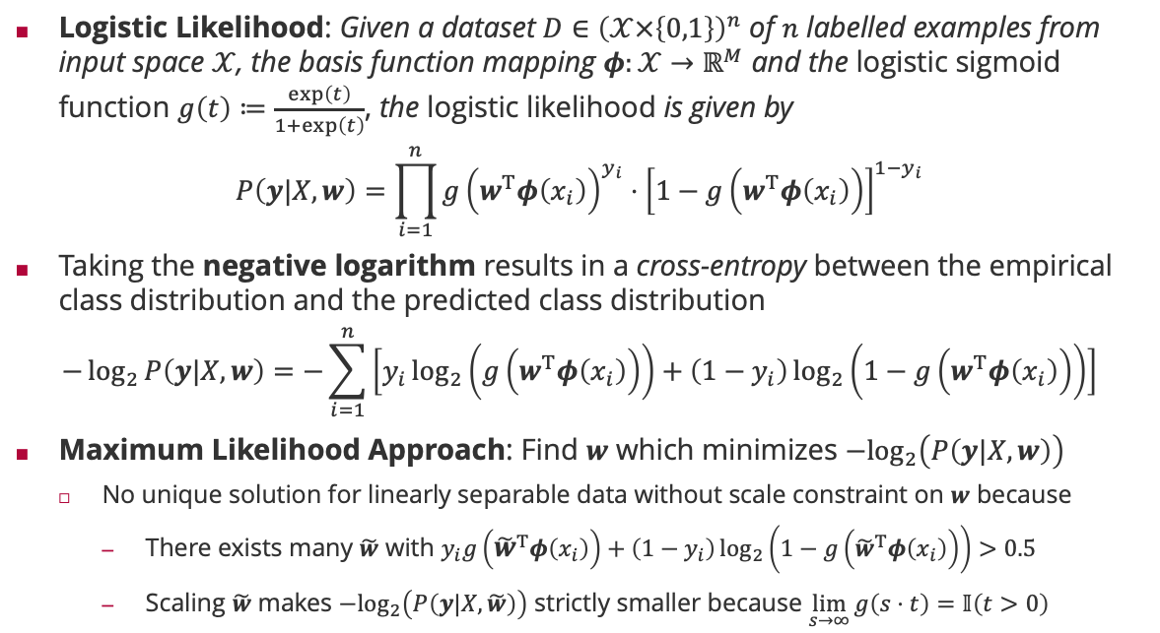

Logistic Likelihood
Logistic Likelihood: Given a dataset $D∈{\left(𝒳×\left\{0,1\right\}\right)}^{n}$ of $n$ labelled examples from input space $𝒳$, the basis function mapping $φ:𝒳→ℝ^{M}$ and the logistic sigmoid function $g\left(t\right)≔\frac{\exp\left(t\right)}{1+\exp\left(t\right)}$, the logistic likelihood is given by
$$P\left(y|X,w\right)=\prod_{i=1}^{n}{{g\left(w^{T}φ\left(x_{i}\right)\right)}^{y_{i}}⋅{\left[1−g\left(w^{T}φ\left(x_{i}\right)\right)\right]}^{1−y_{i}}}$$
Taking the negative logarithm results in a cross-entropy between the empirical class distribution and the predicted class distribution
$$−\log_{2}{P\left(y|X,w\right)}=−\sum_{i=1}^{n}{\left[y_{i}\log_{2}\left(g\left(w^{T}φ\left(x_{i}\right)\right)\right)+\left(1−y_{i}\right)\log_{2}\left(1−g\left(w^{T}φ\left(x_{i}\right)\right)\right)\right]}$$
Maximum Likelihood Approach: Find $w$ which minimizes $−\log_{2}\left(P\left(y|X,w\right)\right)$
No unique solution for linearly separable data without scale constraint on $w$ because
There exists many $\tilde{w}$ with $y_{i}g\left({\tilde{w}}^{T}φ\left(x_{i}\right)\right)+\left(1−y_{i}\right)\log_{2}\left(1−g\left({\tilde{w}}^{T}φ\left(x_{i}\right)\right)\right)>0.5$
Scaling $\tilde{w}$ makes $−\log_{2}\left(P\left(y|X,\tilde{w}\right)\right)$ strictly smaller because $\lim_{s→∞}{g\left(s⋅t\right)=𝕀\left(t>0\right)}$
$$g\left(s⋅t\right)=\frac{\exp\left(s⋅t\right)}{1+\exp\left(s⋅t\right)}$$

Slide 19
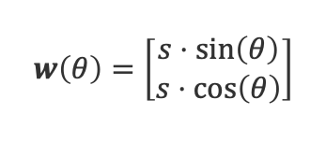


Negative Log-Logistic Likelihood in Action
$$w\left(θ\right)=\left[\begin{matrix}s⋅\sin\left(θ\right) \\ s⋅\cos\left(θ\right)\end{matrix}\right]$$
$$n=18$$
$$n=1000$$

Slide 20
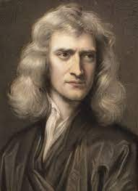
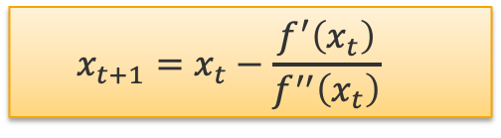
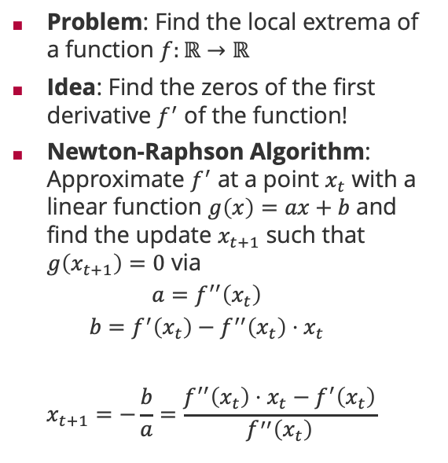
Newton-Raphson Algorithm
Problem: Find the local extrema of a function $f:ℝ→ℝ$
Idea: Find the zeros of the first derivative $f^{′}$ of the function!
Newton-Raphson Algorithm: Approximate $f^{′}$ at a point $x_{t}$ with a linear function $g\left(x\right)=ax+b$ and find the update $x_{t+1}$ such that $g\left(x_{t+1}\right)=0$ via
$$a=f^{′′}\left(x_{t}\right)$$
$$b=f^{′}\left(x_{t}\right)−f^{′′}\left(x_{t}\right)⋅x_{t}$$
$$x_{t+1}=−\frac{b}{a}=\frac{f^{′′}\left(x_{t}\right)⋅x_{t}−f^{′}\left(x_{t}\right)}{f^{′′}\left(x_{t}\right)}$$
Sir Isaac Newton (1643 – 1727)
$$x_{t+1}=x_{t}−\frac{f^{′}\left(x_{t}\right)}{f^{′′}\left(x_{t}\right)}$$

Slide 21
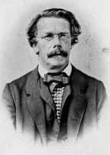
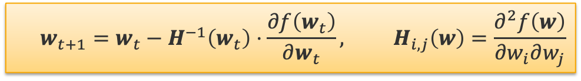
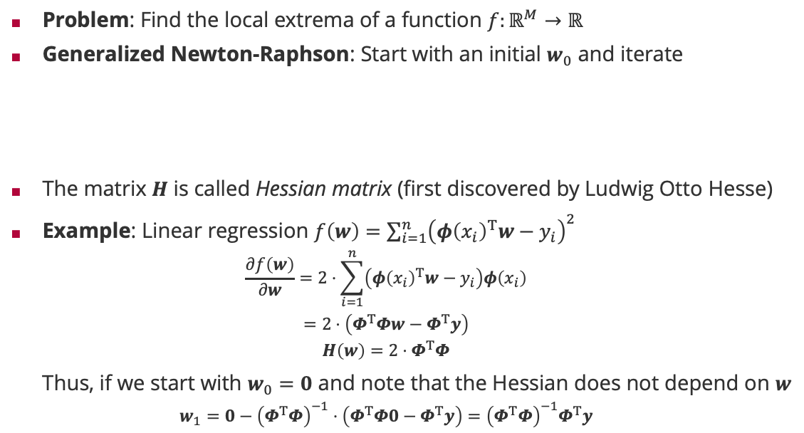

Newton-Raphson in Many Dimensions
Problem: Find the local extrema of a function $f:ℝ^{M}→ℝ$
Generalized Newton-Raphson: Start with an initial $w_{0}$ and iterate
The matrix $H$ is called Hessian matrix (first discovered by Ludwig Otto Hesse)
Example: Linear regression $f\left(w\right)=\sum_{i=1}^{n}{{\left(φ{\left(x_{i}\right)}^{T}w−y_{i}\right)}^{2}}$
$$\frac{∂f\left(w\right)}{∂w}=2⋅\sum_{i=1}^{n}{\left(φ{\left(x_{i}\right)}^{T}w−y_{i}\right)φ\left(x_{i}\right)}$$
$$=2⋅\left(Φ^{T}Φw−Φ^{T}y\right)$$
$$H\left(w\right)=2⋅Φ^{T}Φ$$
Thus, if we start with $w_{0}=0$ and note that the Hessian does not depend on $w$
$$w_{1}=0−{\left(Φ^{T}Φ\right)}^{−1}⋅\left(Φ^{T}Φ0−Φ^{T}y\right)={\left(Φ^{T}Φ\right)}^{−1}Φ^{T}y$$
$$w_{t+1}=w_{t}−H^{−1}\left(w_{t}\right)⋅\frac{∂f\left(w_{t}\right)}{∂w_{t}}, H_{i,j}\left(w\right)=\frac{∂^{2}f\left(w\right)}{∂w_{i}∂w_{j}}$$
Ludwig Otto Hesse (1811 – 1874)
Matrix Derivatives
$$\frac{∂Ax+b}{∂x}=A^{T}$$

Slide 22

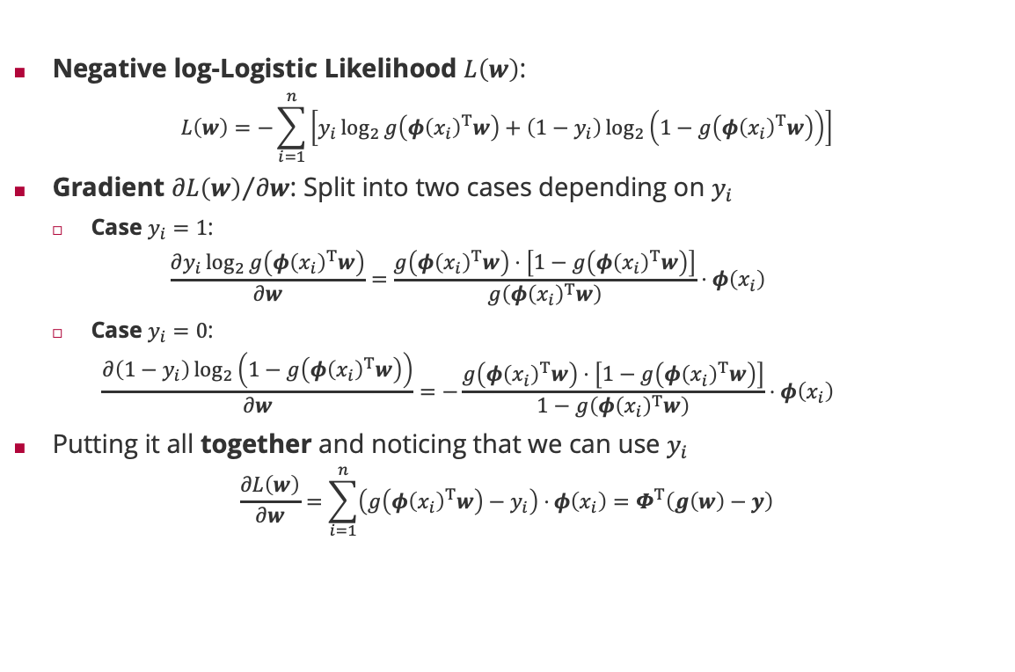


Newton-Raphson for Logistic Regression: Gradient
Negative log-Logistic Likelihood $L\left(w\right)$:
$$L\left(w\right)=−\sum_{i=1}^{n}{\left[y_{i}\log_{2}{g\left(φ{\left(x_{i}\right)}^{T}w\right)}+\left(1−y_{i}\right)\log_{2}\left(1−g\left(φ{\left(x_{i}\right)}^{T}w\right)\right)\right]}$$
Gradient ${∂L\left(w\right)}/{∂w}$: Split into two cases depending on $y_{i}$
Case $y_{i}=1$:
$$\frac{∂y_{i}\log_{2}{g\left(φ{\left(x_{i}\right)}^{T}w\right)}}{∂w}=\frac{g\left(φ{\left(x_{i}\right)}^{T}w\right)⋅\left[1−g\left(φ{\left(x_{i}\right)}^{T}w\right)\right]}{g\left(φ{\left(x_{i}\right)}^{T}w\right)}⋅φ\left(x_{i}\right)$$
Case $y_{i}=0$:
$$\frac{∂\left(1−y_{i}\right)\log_{2}\left(1−g\left(φ{\left(x_{i}\right)}^{T}w\right)\right)}{∂w}=−\frac{g\left(φ{\left(x_{i}\right)}^{T}w\right)⋅\left[1−g\left(φ{\left(x_{i}\right)}^{T}w\right)\right]}{1−g\left(φ{\left(x_{i}\right)}^{T}w\right)}⋅φ\left(x_{i}\right)$$
Putting it all together and noticing that we can use $y_{i}$
$$\frac{∂L\left(w\right)}{∂w}=\sum_{i=1}^{n}{\left(g\left(φ{\left(x_{i}\right)}^{T}w\right)−y_{i}\right)⋅}φ\left(x_{i}\right)=Φ^{T}\left(g\left(w\right)−y\right)$$
Sigmoid Derivative
$$\frac{dg\left(t\right)}{dt}=g\left(t\right)⋅\left[1−g\left(t\right)\right]$$
Matrix Derivatives
$$\frac{∂Ax+b}{∂x}=A^{T}$$
$$\left[\begin{matrix}g\left(φ{\left(x_{1}\right)}^{T}w\right) \\ ⋮ \\ g\left(φ{\left(x_{n}\right)}^{T}w\right)\end{matrix}\right]$$

Slide 23

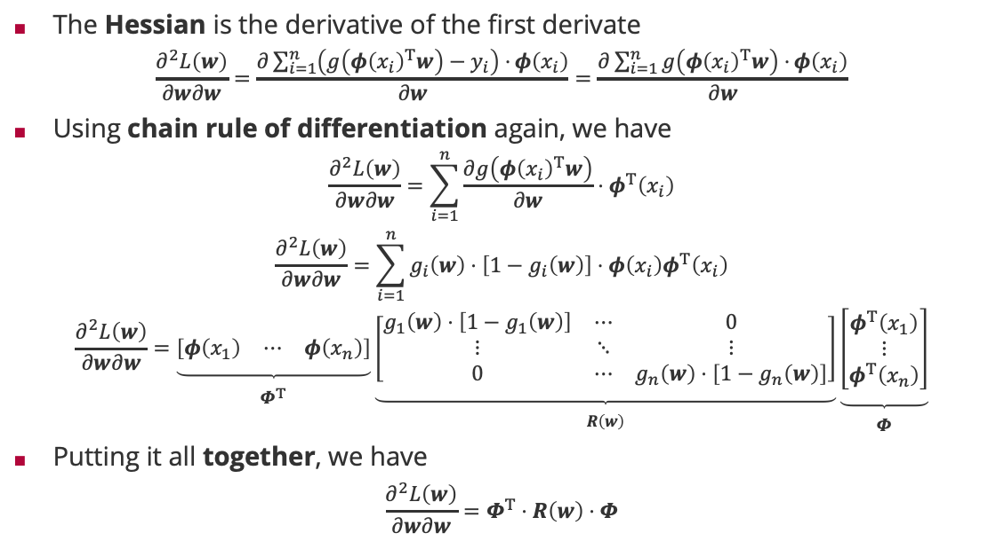

Newton-Raphson for Logistic Regression: Hessian
The Hessian is the derivative of the first derivate
$$\frac{∂^{2}L\left(w\right)}{∂w∂w}=\frac{∂\sum_{i=1}^{n}{\left(g\left(φ{\left(x_{i}\right)}^{T}w\right)−y_{i}\right)⋅}φ\left(x_{i}\right)}{∂w}=\frac{∂\sum_{i=1}^{n}{g\left(φ{\left(x_{i}\right)}^{T}w\right)⋅}φ\left(x_{i}\right)}{∂w}$$
Using chain rule of differentiation again, we have
$$\frac{∂^{2}L\left(w\right)}{∂w∂w}=\sum_{i=1}^{n}{\frac{∂g\left(φ{\left(x_{i}\right)}^{T}w\right)}{∂w}⋅φ^{T}\left(x_{i}\right)}$$
$$\frac{∂^{2}L\left(w\right)}{∂w∂w}=\sum_{i=1}^{n}{g_{i}\left(w\right)⋅\left[1−g_{i}\left(w\right)\right]⋅φ\left(x_{i}\right)φ^{T}\left(x_{i}\right)}$$
$$\frac{∂^{2}L\left(w\right)}{∂w∂w}=\underset{\begin{aligned} \\ Φ^{T}\end{aligned}}{\underbrace{\left[\begin{matrix}φ\left(x_{1}\right) & ⋯ & φ\left(x_{n}\right)\end{matrix}\right]}}\underset{\begin{aligned} \\ R\left(w\right)\end{aligned}}{\underbrace{\left[\begin{matrix}g_{1}\left(w\right)⋅\left[1−g_{1}\left(w\right)\right] & ⋯ & 0 \\ ⋮ & ⋱ & ⋮ \\ 0 & ⋯ & g_{n}\left(w\right)⋅\left[1−g_{n}\left(w\right)\right]\end{matrix}\right]}}\underset{\begin{aligned} \\ Φ\end{aligned}}{\underbrace{\left[\begin{matrix}φ^{T}\left(x_{1}\right) \\ ⋮ \\ φ^{T}\left(x_{n}\right)\end{matrix}\right]}}$$
Putting it all together, we have
$$\frac{∂^{2}L\left(w\right)}{∂w∂w}=Φ^{T}⋅R\left(w\right)⋅Φ$$
Sigmoid Derivative
$$\frac{dg\left(t\right)}{dt}=g\left(t\right)⋅\left[1−g\left(t\right)\right]$$
Matrix Derivatives
$$\frac{∂Ax+b}{∂x}=A^{T}$$

Slide 24
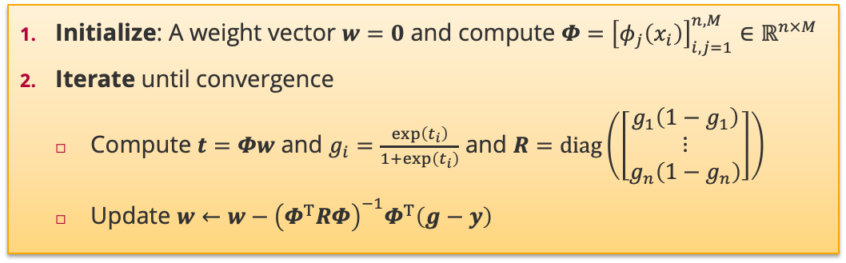

Logistic Regression: Iterative Reweighted Least Square
Given: A data set $\left\{\left(x_{1},y_{1}\right),…,\left(x_{n},y_{n}\right)\right\}⊆\left(𝒳×\left\{0,1\right\}\right)$ and a basis function mapping $φ:𝒳→ℝ^{M}$
Initialize: A weight vector $w=0$ and compute $Φ={\left[φ_{j}\left(x_{i}\right)\right]}_{i,j=1}^{n,M}∈ℝ^{n×M}$
Iterate until convergence
Compute $t=Φw$ and $g_{i}=\frac{\exp\left(t_{i}\right)}{1+\exp\left(t_{i}\right)}$ and $R=diag\left(\left[\begin{matrix}g_{1}\left(1−g_{1}\right) \\ ⋮ \\ g_{n}\left(1−g_{n}\right)\end{matrix}\right]\right)$
Update $w←{w−\left(Φ^{T}RΦ\right)}^{−1}Φ^{T}\left(g−y\right)$

Slide 25
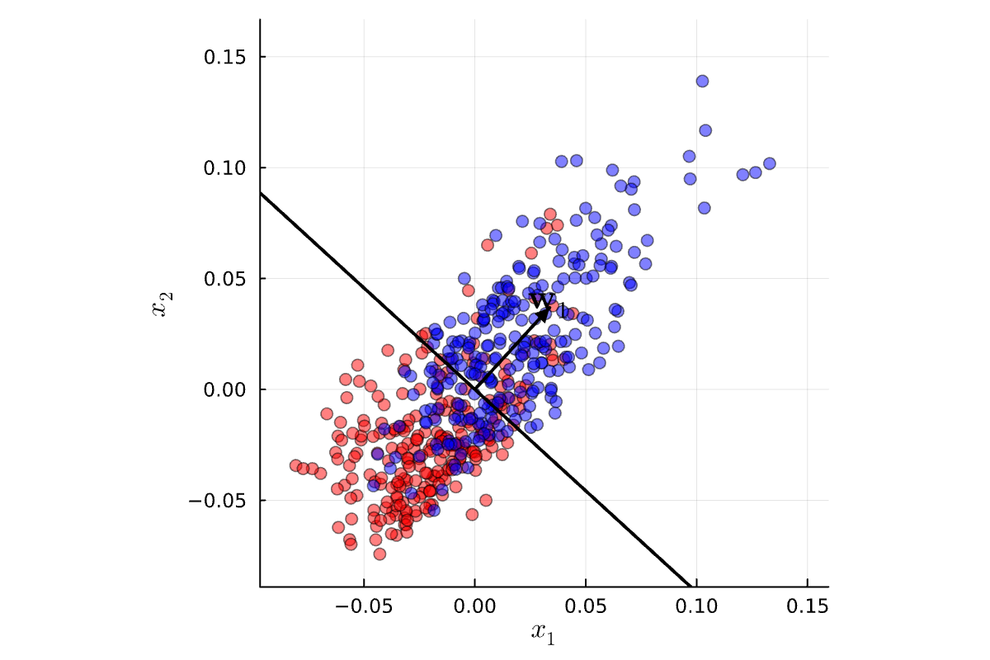
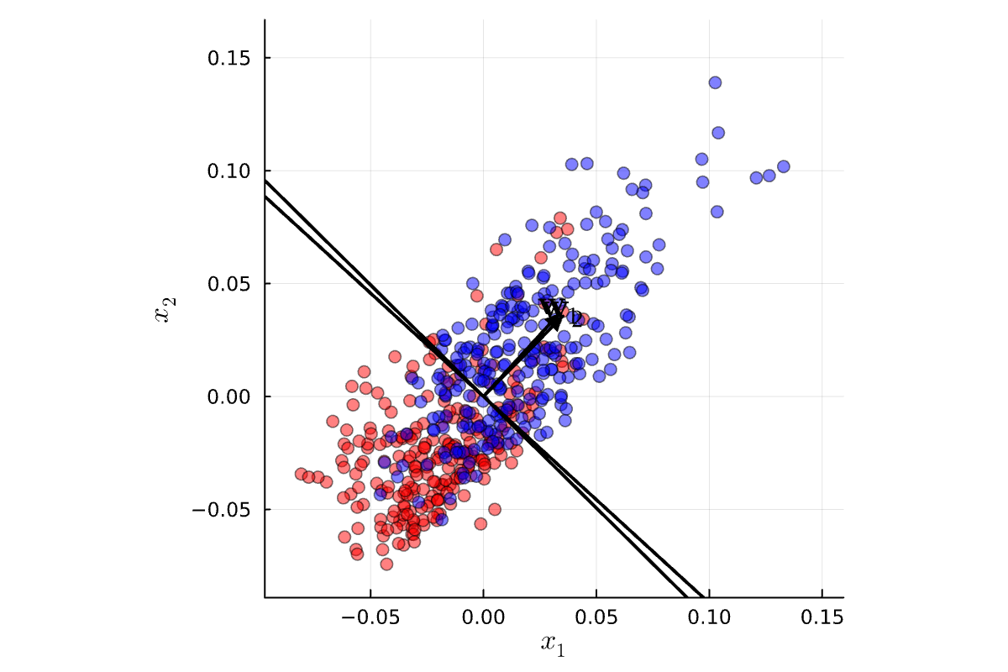

Logistic Regression in Action
Iteration 1
Iteration 2
Iteration 3

Slide 26
Summary
Classification
The likelihood model is no longer conjugate to the prior over the weight vector
A linear classifier has an interpretable geometry in high-dimensional spaces
Maximum Likelihood: Fisher’s Linear Discriminant
Rooted in the idea of finding a projection direction where inter-class distances are maximized while intra-class distances are minimized
Relatively simple and efficient to compute!
Perceptron Learning Algorithm
The first classification learning algorithm which is still very relevant and performant!
Elegant geometric convergence proof which bounds the number of update steps
Logistic Regression
Assumes a logistic likelihood model (rather than a probit)
Iterative optimization procedure using gradient descent

Slide 27
See you next week!

